Slide 1
SENTIMENT ANALYSIS OF COVID-19 TWEETS – VISUALIZATION DASHBOARD
By
Mohammed Sohel
Digvijaysinh Zala

Slide 2
OVERVIEW
Sentiment analysis nowadays can be considered as one of the most popular research topics in the field of natural language processing. The uses of sentiment analysis are covered by some interesting scientific and commercial areas, such as opinion mining, recommender systems, and event detection.
Nowadays the social media platforms such as Twitter, Facebook and YouTube, are a great source of information known as social data. The events occurring in normal daily life are discussed on social media and any individuals are free to discuss and express their opinion about these events.
Coronavirus known as COVID-19 which began to appear at the end of last year in Wuhan, China has been one of the most discussed and one of the most spreading diseases worldwide.

Slide 3
PURPOSE
The applications of sentiment analysis are broad and powerful. The ability to extract insights from social data is a practice that is being widely adopted by organizations across the world. Shifts in sentiment on social media have been shown to correlate with shifts in the stock market. main purpose of this system is know the behavior of the people in given situation. so we know what people actually think regarding this. it will help in business.

Slide 4
EXISTING PROBLEM
The Existing applications are more complex to create and the analysis which are been rendered are not analyzed properly. the application needed updated every single day so real time analysis will help. also their are general system required so any situation we use that system.
PROPOSED SOLUTION
Using Python inbuilt library development much easy and reduces the complexity of the application. With the help of tweepy library makes it easy to make dataset.
Using the sentimental analysis for each tweet and find the data which shows the tweets polarity so we know people thought regarding situation.
With the help of Dash UI representation in the python. The graph and gui will easy to make and interactive.

Slide 5
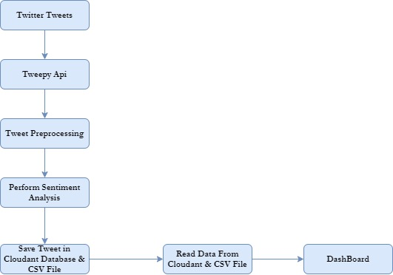
FLOW CHART

Slide 6
EXPERIMENTAL INVESTIGATIONS
In this process of developing the project I have undergone many investigation processes to learn and understand new concepts so that I can build the SENTIMENT DASHBOARD successfully. For I had to learn and investigate following:
IBM Cloud Cloudant.
tweepy
Dash
ZOHO Writer
Nltk
Wordcloud
Mapbox

Slide 7
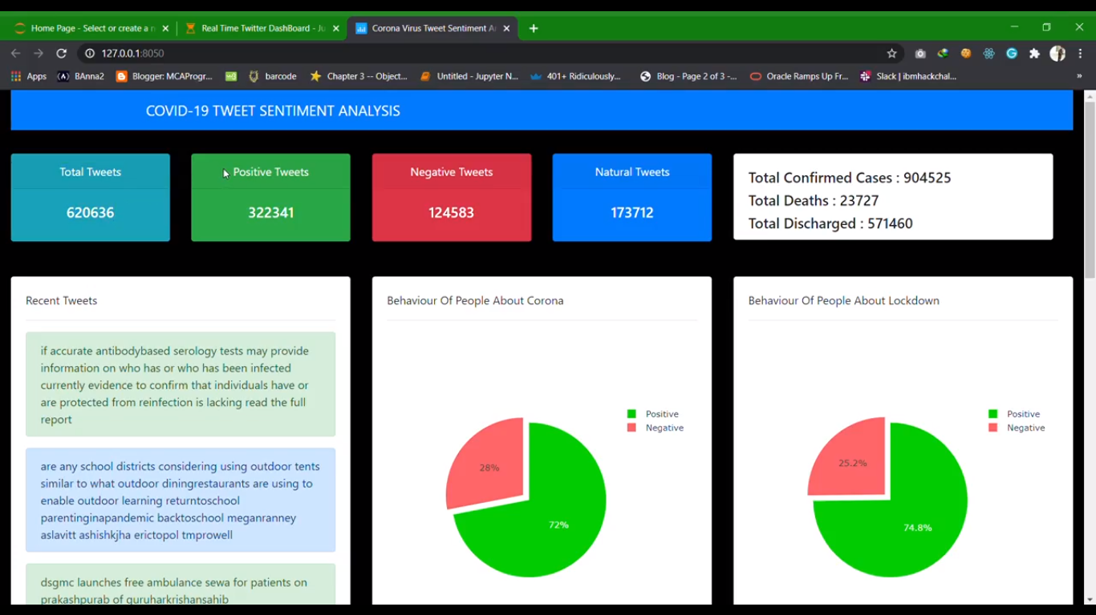
RESULT

Slide 8
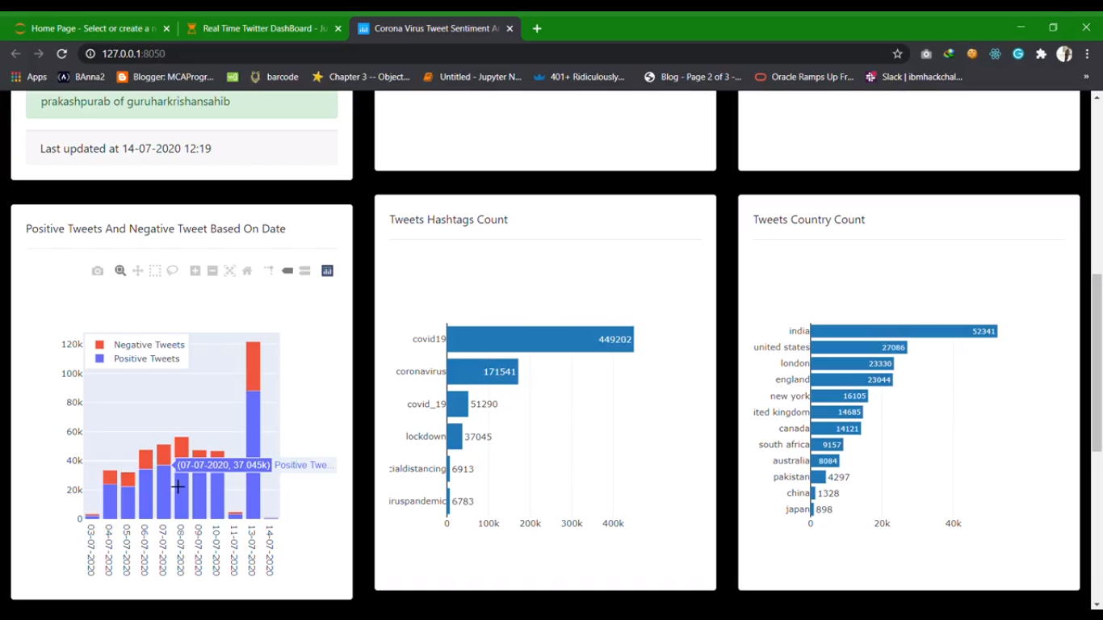

Slide 9
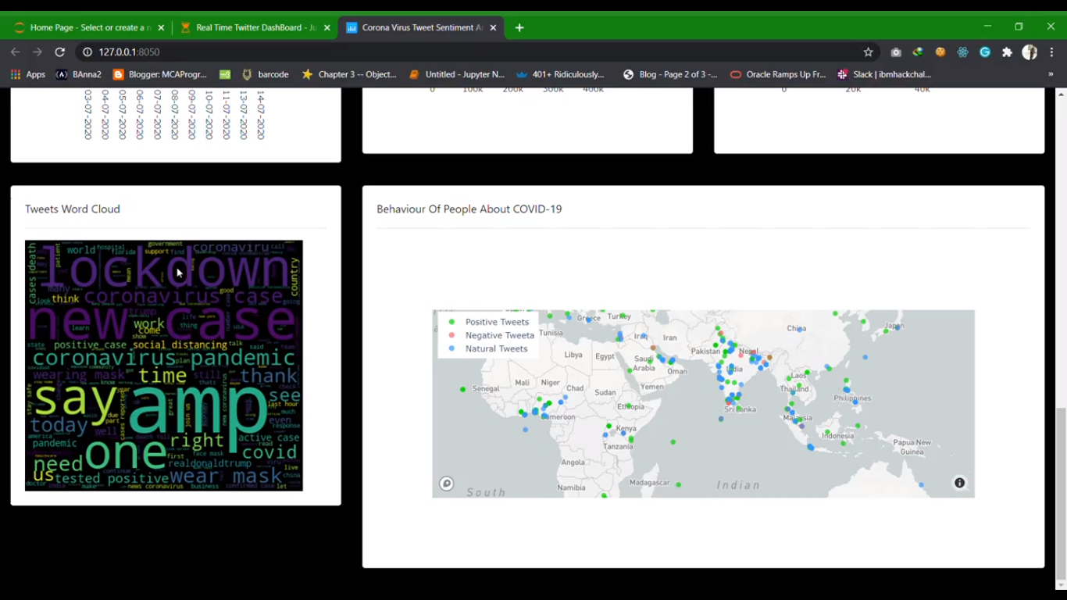

Slide 10
VIDEO EXPLANATION OF SYSTEM
https://drive.google.com/file/d/1Vvq92maFvGHWaNIv6Nf8S33Tb7k1yYse/view?usp=sharing

Slide 11
THANK YOU

